Slide 1
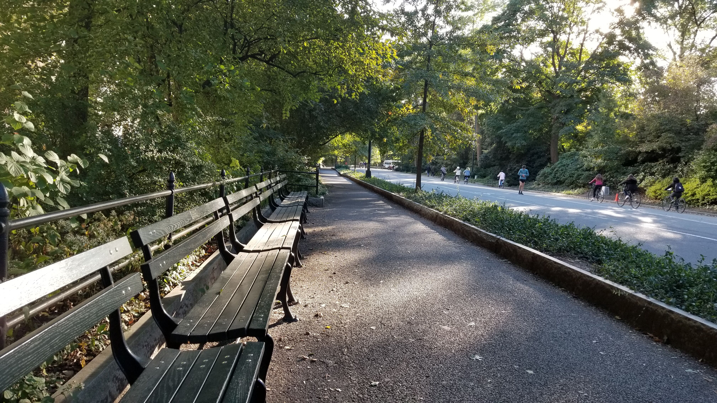
PREDICTING THE HEALTH OF CITY TREES
by Bill Ott

Slide 2
BACKGROUND
Urban trees are super great
Each decade NYC Parks and Rec conducts TreeCount! - a literal census for street trees
Last conducted in 2015
Data is publicly available from NYC Open Data

Slide 3
STARTING POINT
HYPOTHESIS
Conditional factors, such as how well maintained a tree is, as well as a tree's physical location, and the type of tree itself will contribute to whether or not a tree is healthy.
APPROACH
Utilize sci-kit learn’s Logistic Regression model to classify the ‘health’ status of NYC’s trees based on these factors.

Slide 4
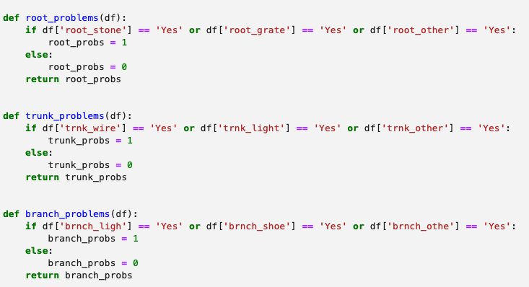
ABOUT THE DATA
650k+ rows; ‘tree-level’ granularity
42 columns – mostly categorical (e.g. boro)
Dataset required minimal cleansing
Data was subset to trees with ‘Alive’ status
Manufactured comprehensive “problems” columns
#treeproblems

Slide 5
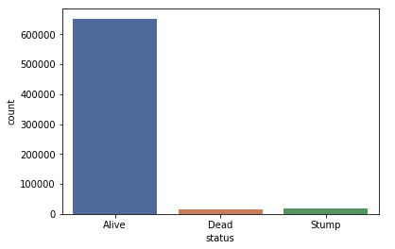
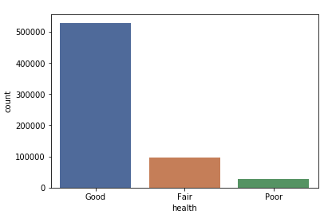
STATUS

Slide 6
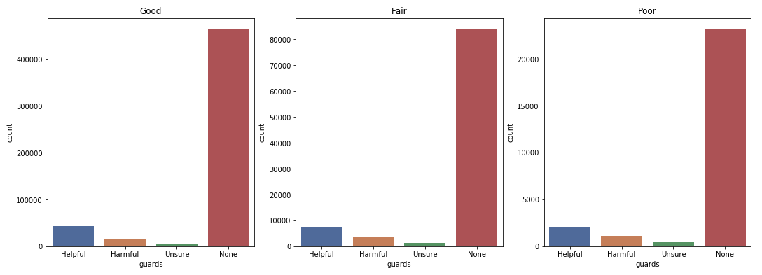
GuarDs

Slide 7
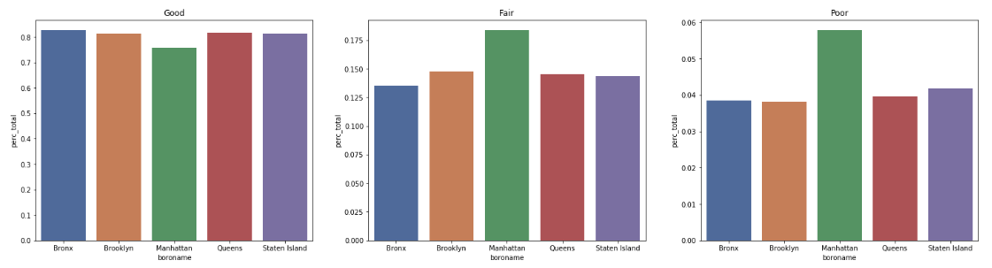
STATUS BY BORO

Slide 8
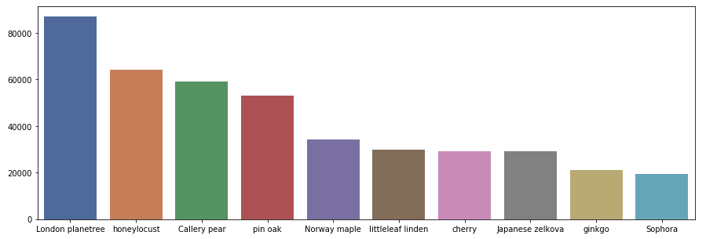
TOP 10 SPECIES

Slide 9
TOP 10 SPECIES RANKINGS BY STATUS
GOOD
London Planetree
Honeylocust
Callery Pear
Pin Oak
Japanese Zelkova
Cherry
Littleleaf Linden
Norway Maple
Ginko
Sophora
FAIR
London Planetree
Norway Maple
Callery Pear
Honeylocust
Pin Oak
Littleleaf Linden
Cherry
Japanese Zelkova
Red Maple
Sophora
POOR
Norway Maple
London Planetree
Callery Pear
Littleleaf Linden
Cherry
Pin Oak
Honeylocust
Ginko
Red Maple
Japanese Zelkova

Slide 10
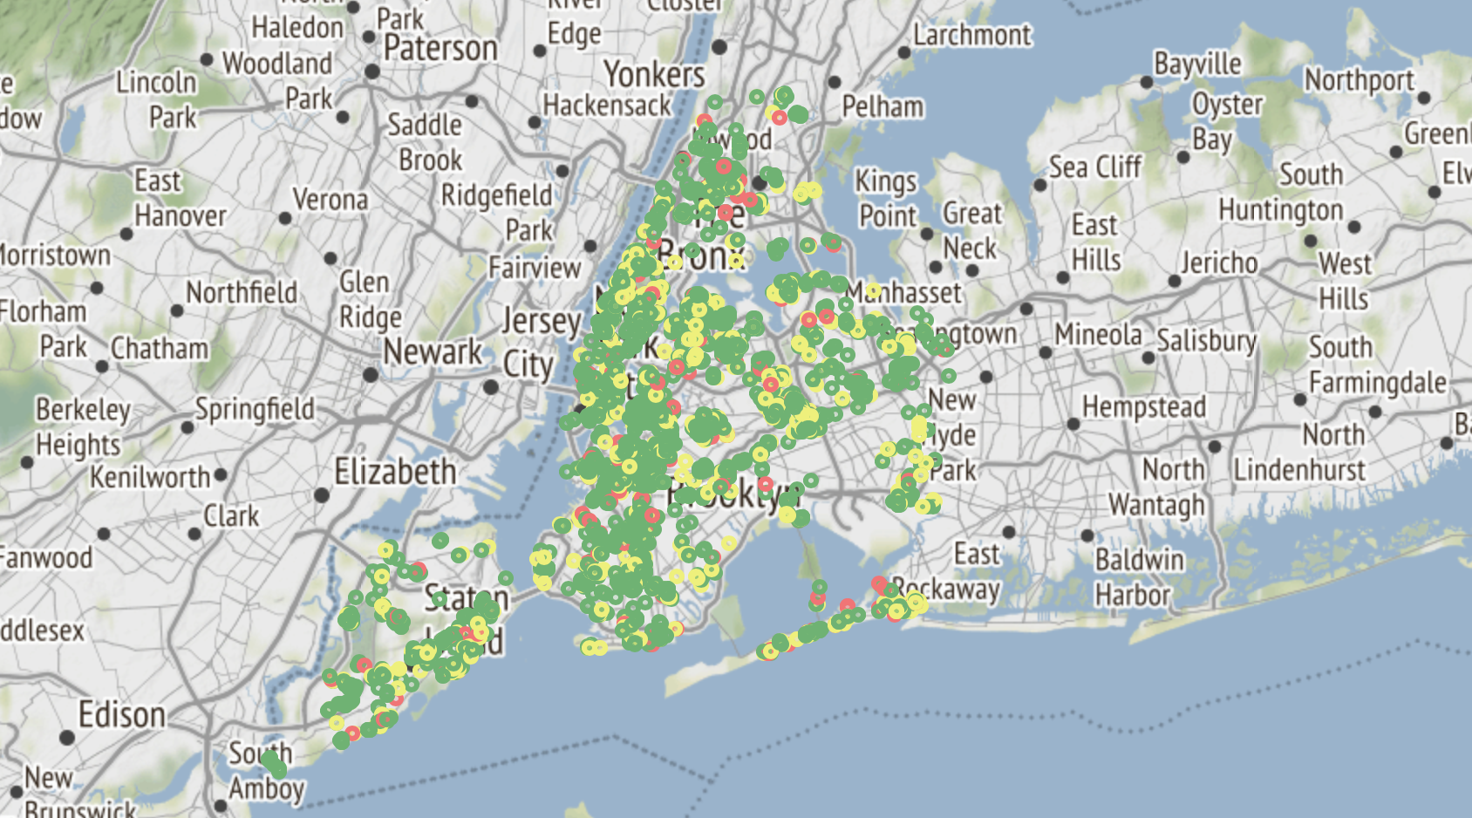
Mapping THE TREES
Mapped with Folium; first 5,000 rows represented

Slide 11
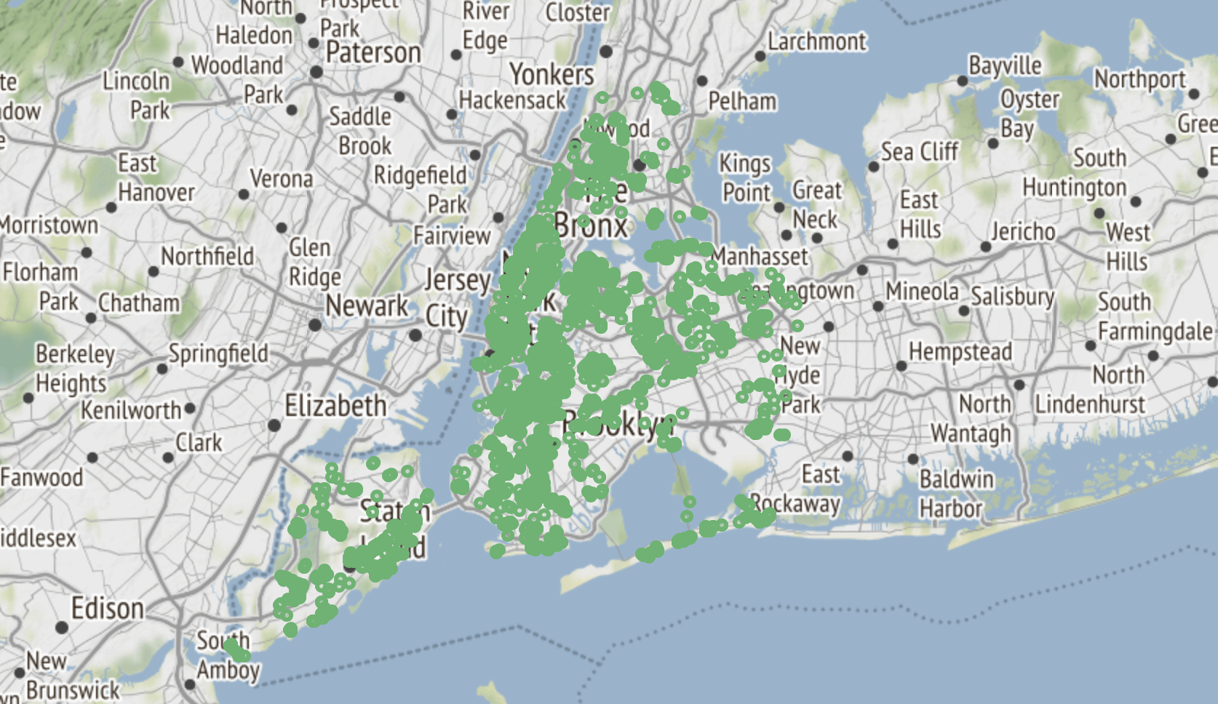
Mapping THE TREES (GOOD ONLY)
Mapped with Folium; first 5,000 rows (Good health) represented

Slide 12
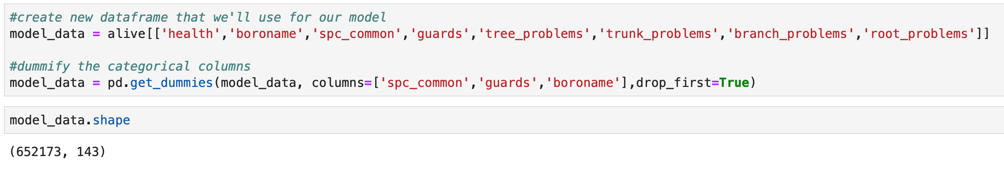
PREPARING our data
Before instantiating and fitting the model I…
Dummified the feature columns
Dropped rows with null values
Modified the response to be binary (Good vs. Not Good)
Split the data into train & test sets
Utilize automated feature selection (SelectPercentile @ 50%)

Slide 13
LOGISTIC REGRESSION SCORES
X TRAIN (ALL FEATURES)
X TRAIN (SELECTED)
PROPORTION MAJORITY CLASS
81.2%
81.3%
81.1%

Slide 14
CONCLUSIONS
TUNING
Tried many different feature column combos
Adjusted for the class imbalance (class_weight = ‘balanced’)
Left responses as multinomial
ASSESSMENT
Barely beat proportion of the majority class
Better performance = exceed
Model may not be super strong :(
NEXT STEPS
Crime rate
Income
Population
Proximity to restaurants
Average height of buildings

Slide 15
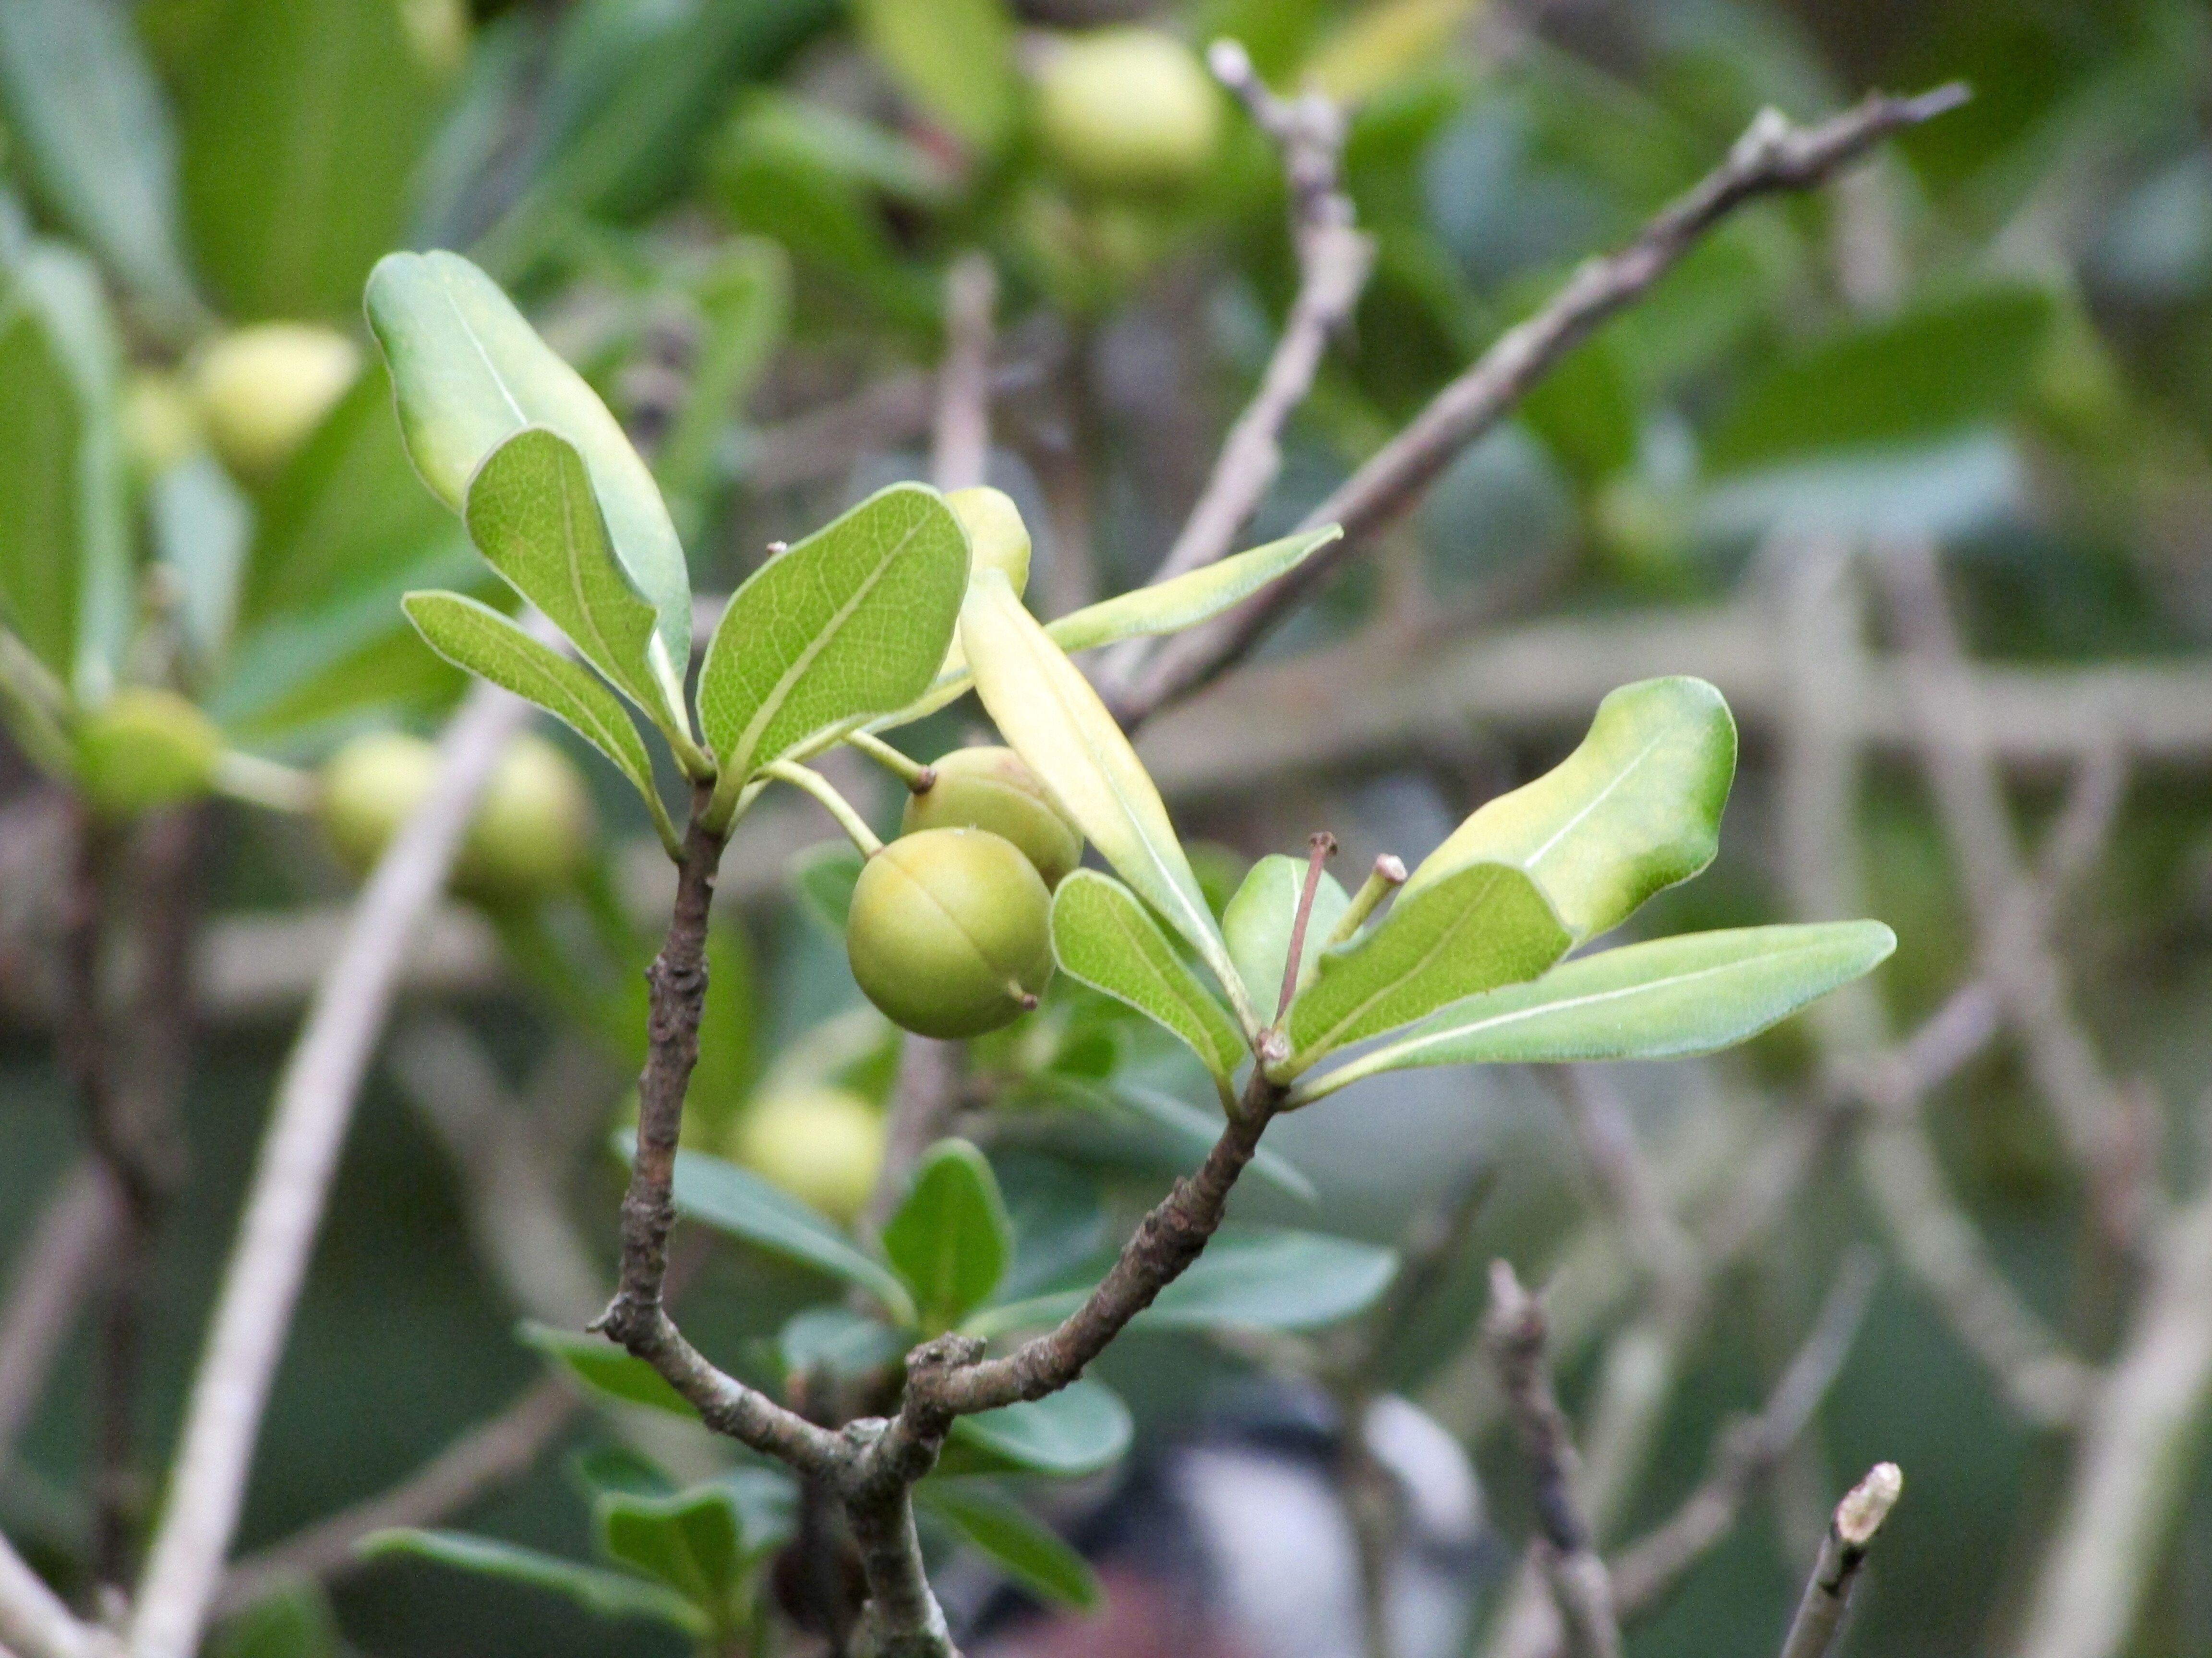
THANK YOU!

